Slide 1
Telecom – Churn Rate ML
SALMAN FARIS C P
​​

Slide 2

Business Case:
No-Churn Telecom is an established Telecom operator in Europe
with more than a decade in Business. Due to new players in the
market, telecom industry has become very competitive and
retaining customers becoming a challenge.
In spite of No-Churn initiatives of reducing tariffs and promoting
more offers, the churn rate ( percentage of customers migrating to
competitors) is well above 10%.
No-Churn wants to explore possibility of Machine Learning to help
with following use cases to retain competitive edge in the industry.

Slide 3

Project goal:
Help No-Churn with their use cases with ML
1. Understanding the variables that are influencing the customers
to migrate.
2. Creating Churn risk scores that can be indicative to drive
retention campaigns.
3. Introduce new predicting variable “CHURN-FLAG” with values
YES(1) or NO(0) so that email campaigns with lucrative offers
can be targeted to Churn YES customers help to identify possible CHURN-FLAG YES customers and provide
more attention in customer touch point areas, including customer
care support, request fulfilment, auto categorizing tickets as high
priority for quick resolutions any questions they may have etc.,

Slide 4
DATA
DataBase Details:
SQL database
DB Name: project_telecom
Table Name: telecom_churn_data
Host: 18.136.157.135
Username: dm_team3
Password: DM!$!Team!27@9!20&

Slide 5
Meta Info of Data
State
4617 non-null object
Account Length
4617 non-null int64
Area Code
4617 non-null int64
Phone
4617 non-null object
International Plan 4617 non-null object
VMail Plan
4617 non-null object
VMail Message
4617 non-null int64
Day Mins
4617 non-null float64
Day Calls
4617 non-null int64
Day Charge
4617 non-null float64
Eve Mins
4617 non-null float64
Eve Calls
4617 non-null int64
Eve Charge
4617 non-null float64
Night Mins
4617 non-null float64
Night Calls
4617 non-null int64
Night Charge
4617 non-null float64
International Mins 4617 non-null float64
International calls 4617 non-null int64
International Charge 4617 non-null float64
CustServ Calls
4617 non-null int64
Churn
4617 non-null object

Slide 6
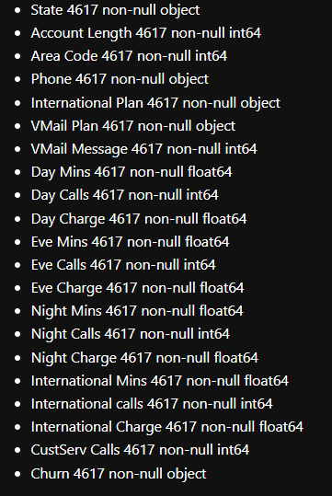
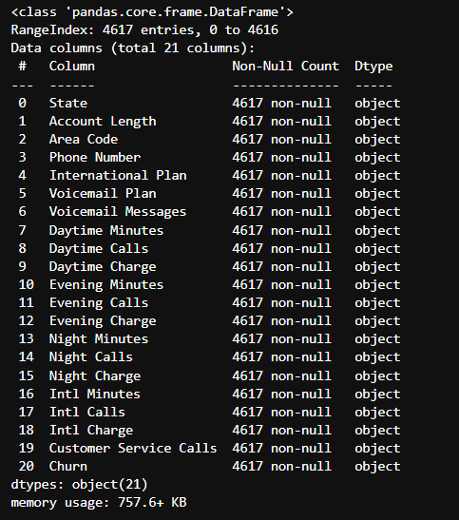

Slide 7
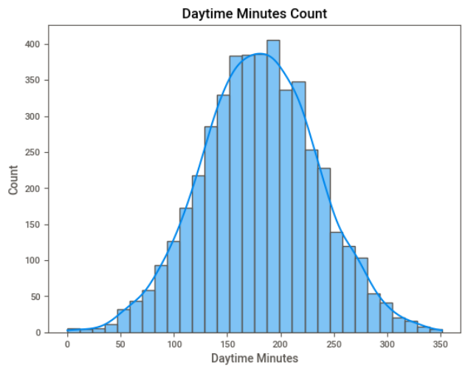
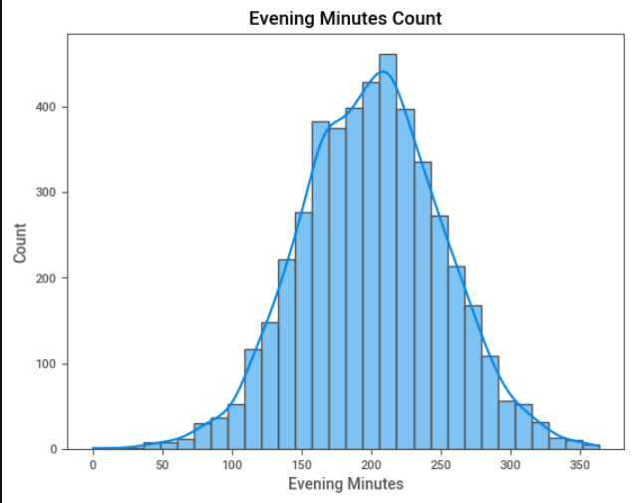
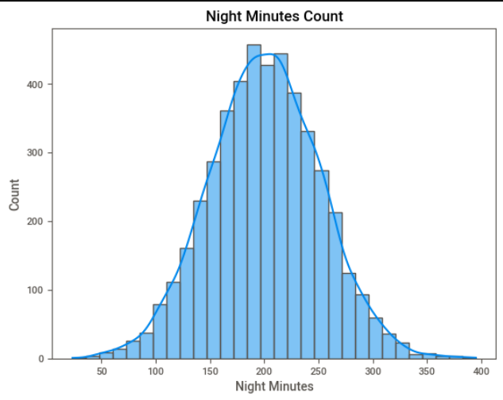
Count graph

Slide 8
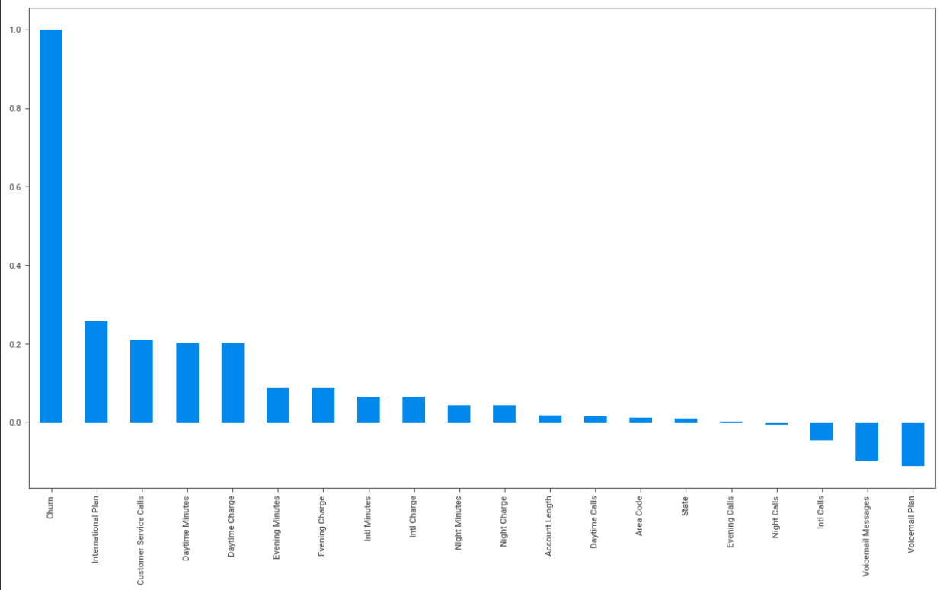
Churn correlation:

Slide 9
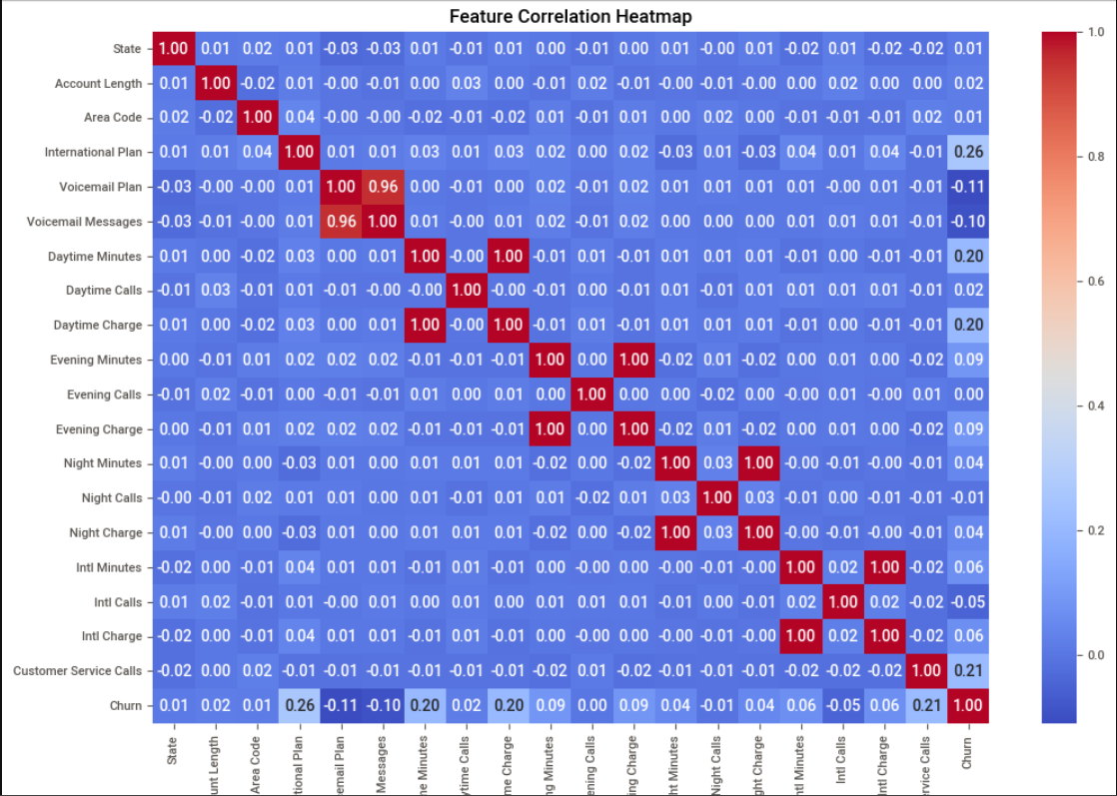
Correlation heatmap:

Slide 10
ML MODELING

Slide 11
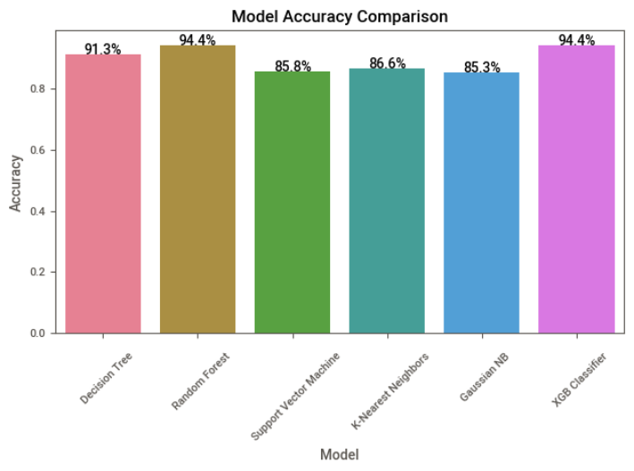
Model accuracy train data:

Slide 12
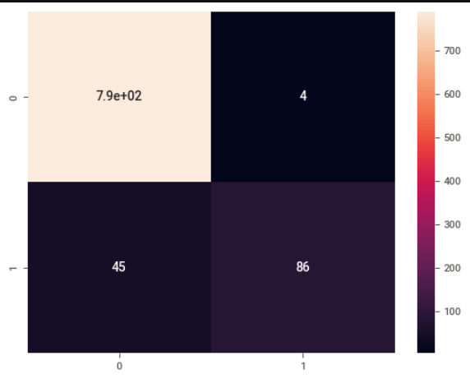
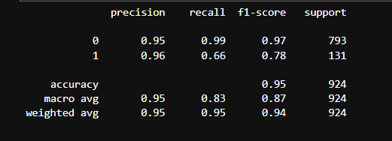
Random Forest Classifier:

Slide 13
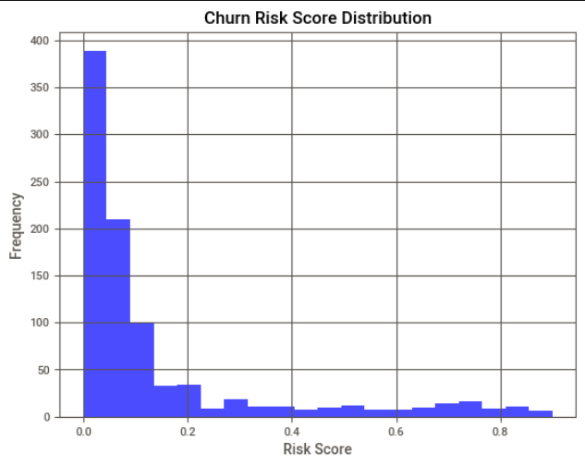
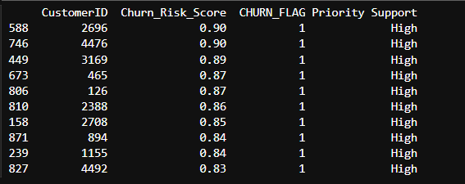
CHURN RISK SCORE

Slide 14
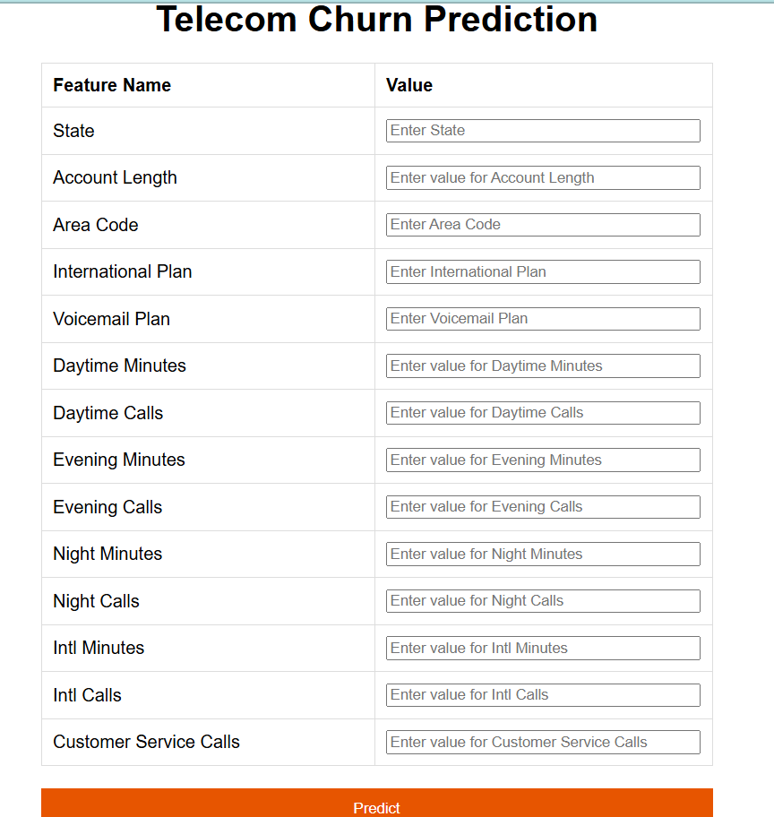
DEPLOYMENT

Slide 15
Conclusion for Telecom Churn Prediction Project:-
Understanding Churn Drivers:The project identified key factors influencing customer churn, such as customer service calls, international plan subscription, and usage patterns (e.g., minutes used, number of calls).This insight enables the business to focus on these areas to reduce churn.- Model Performance:A machine learning model was developed and achieved an accuracy of 95%, effectively classifying customers into "Churn" or "No Churn."The confusion matrix, precision, recall, and F1-score showed that the model performs well in identifying customers likely to churn.- Risk Identification:Churn risk scores were generated for each customer. This allows the business to prioritize customers with a high risk of churn and focus retention strategies on them.A top 10 list of high-risk customers was identified for immediate action.- Actionable Insights:Customers identified as high-risk should be targeted with personalized retention strategies:Retention campaigns with tailored offers to encourage them to stay.Improved customer support with quick resolution of issues.Monitoring high-risk customers for early signs of dissatisfaction.- Business Impact:By focusing on the identified churn drivers and risk scores, the company can reduce churn rates, improve customer satisfaction, and increase revenue through better customer retention.- Future Enhancements:Implementing real-time churn prediction to take immediate action on at-risk customers.Incorporating more advanced techniques, such as deep learning or ensemble models, to further enhance predictive accuracy.Expanding the dataset with additional customer behavior metrics for deeper insights.This project provides the company with a solid foundation for understanding customer behavior and implementing proactive measures to minimize churn.

Slide 16
Churn Drivers:Features like customer service calls, international plan subscriptions, and call/usage patterns were influential in predicting churn.Customers with high customer service call volumes were more likely to churn.- Customer Segmentation:Risk scores allowed for identifying high-risk customers, enabling the company to target these customers with retention strategies.- Model Limitations:The model performed better in predicting non-churners than churners, reflecting a potential class imbalance issue.The recall for the "Churn" class (94%) indicates that some churners were misclassified as non-churners, leading to missed opportunities for retention.Retention Strategies:High-risk customers were identified based on churn risk scores. Proactive actions, such as personalized offers and improved customer service, can be implemented for these customers.Business Value:By addressing high-risk churners and focusing on key factors influencing churn, the company can reduce churn rates and improve customer satisfaction, directly impacting revenue.

Slide 17
Thank you
PTID-CDS-DEC-24-2291

